Slide 1
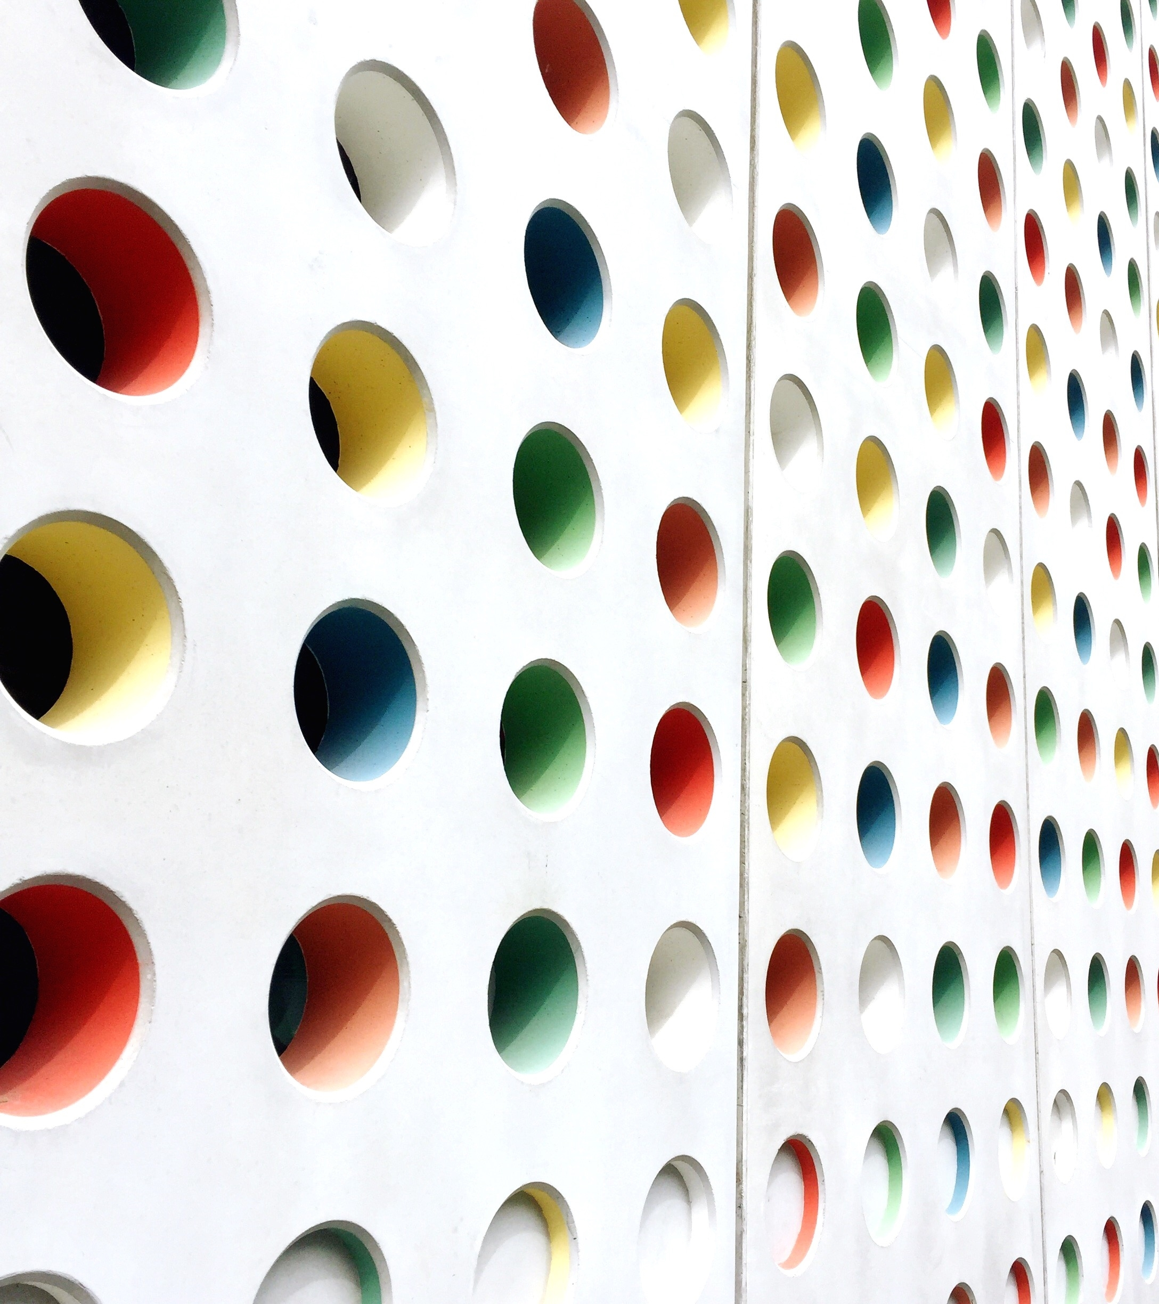
Auburndale Development
Community Development 2023

Slide 2
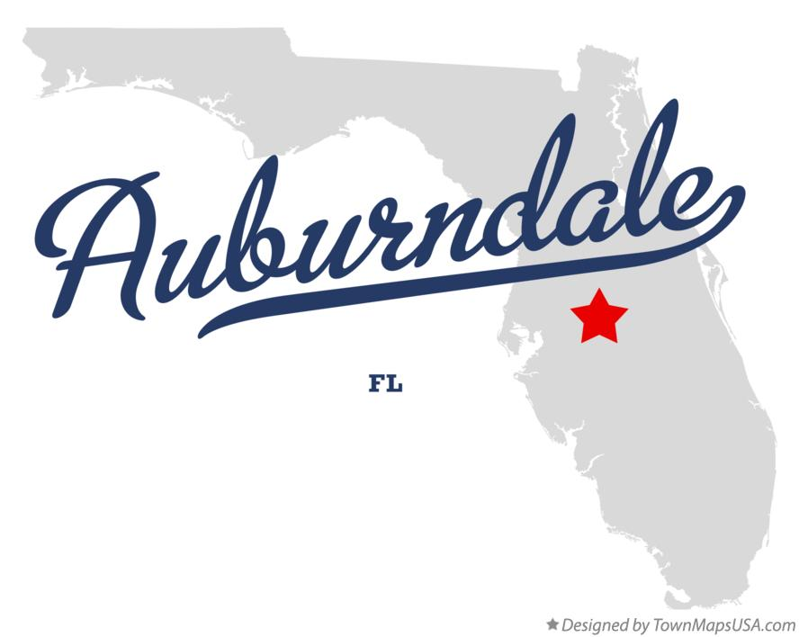
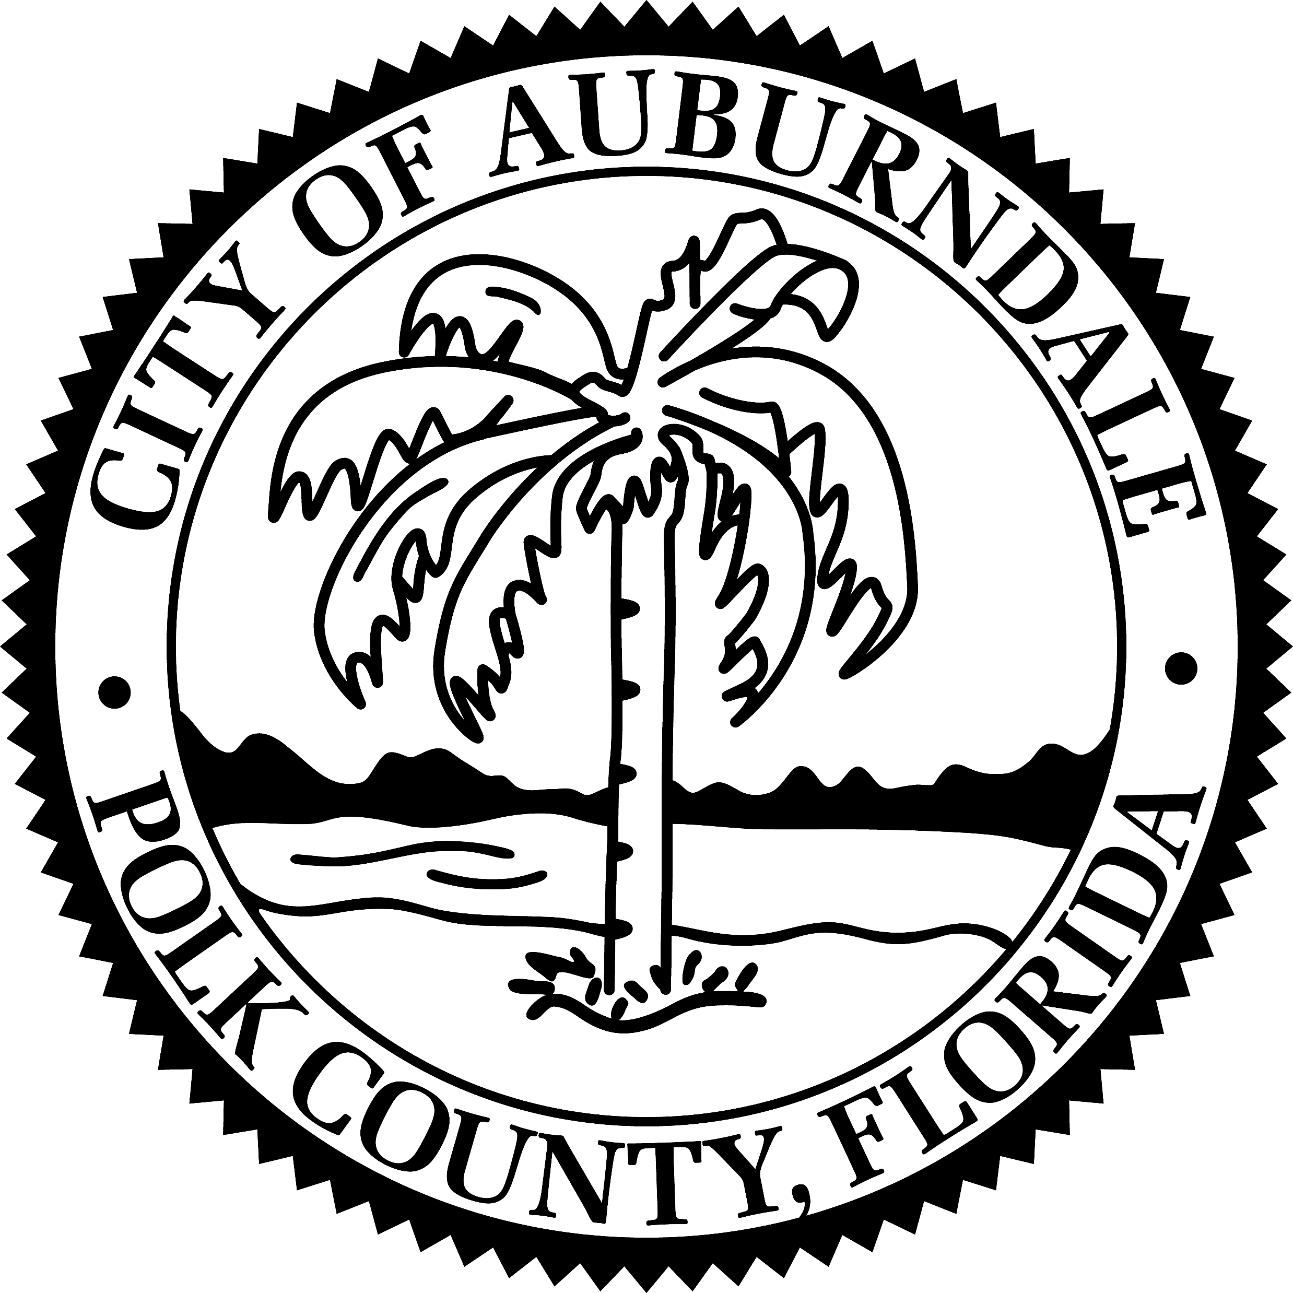
Florida - fastest growing state in nation
Polk County – fastest growing County in state, 5th in nation for growth
Auburndale Population: 17,453
Mayor Dorothea Taylor Bogert
Notes:
In 2022, Florida averaged 1,142 people moving to the state each day.
The Florida Citrus industry is undergoing a tremendous paradigm as citrus greening continues to reduce acreage, further exacerbating the pressure to convert the land to other uses.
Polk County experienced more people moving to Polk County per day than Orange and Hillsborough County from 2020-2022.

Slide 3
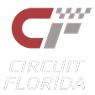
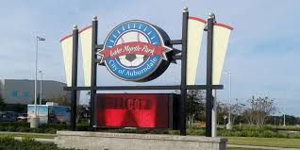
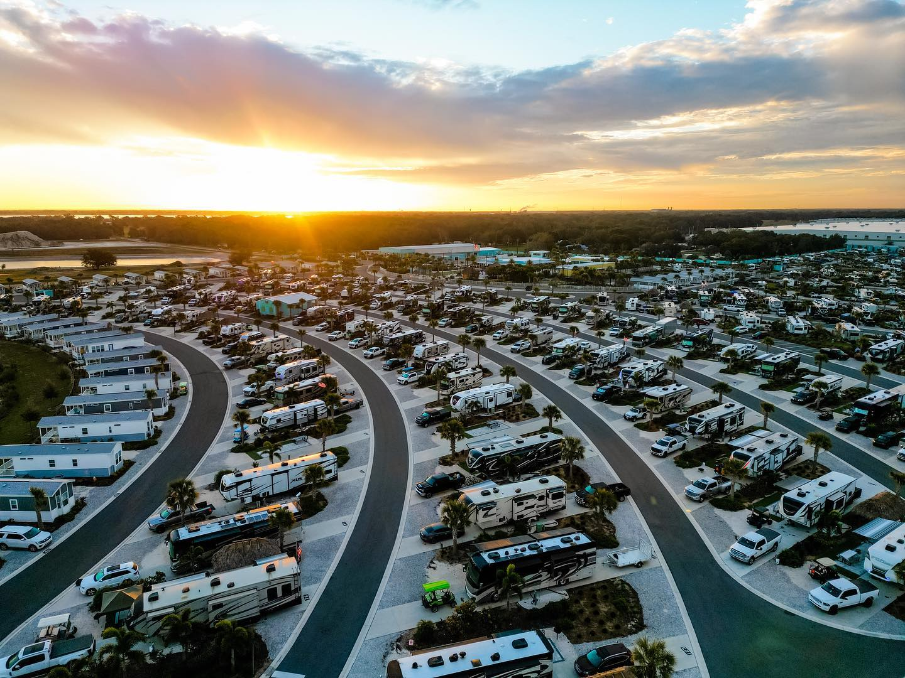
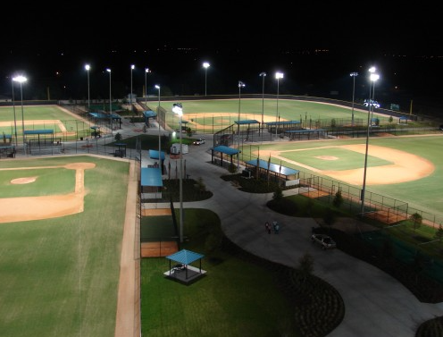
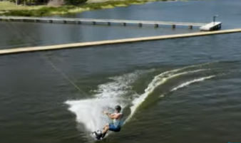
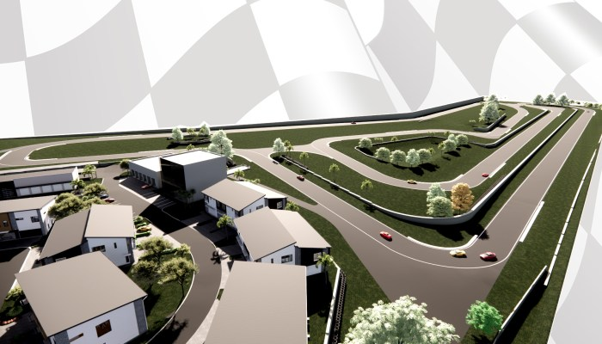
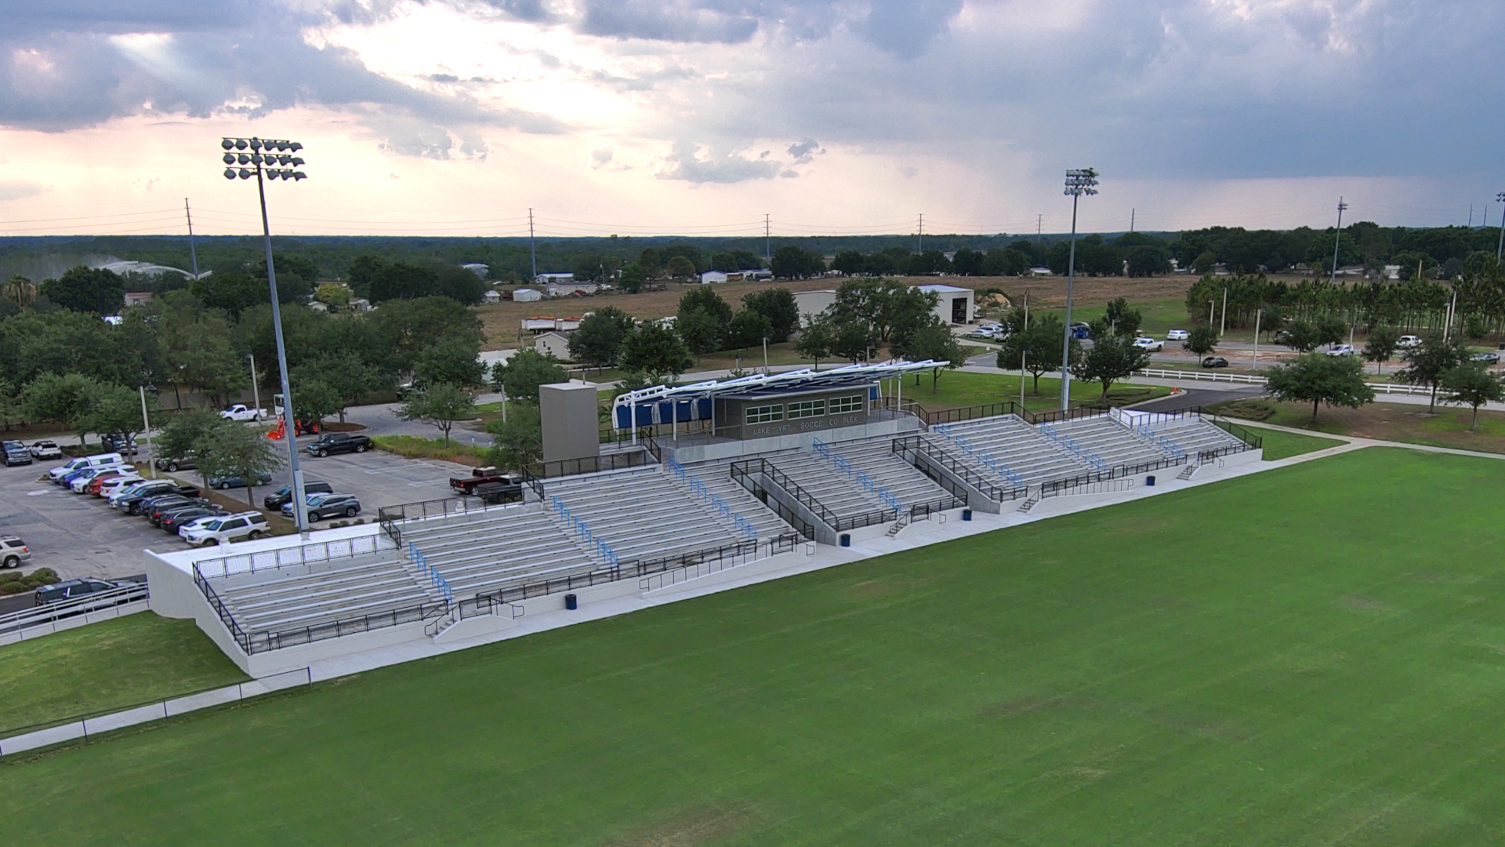
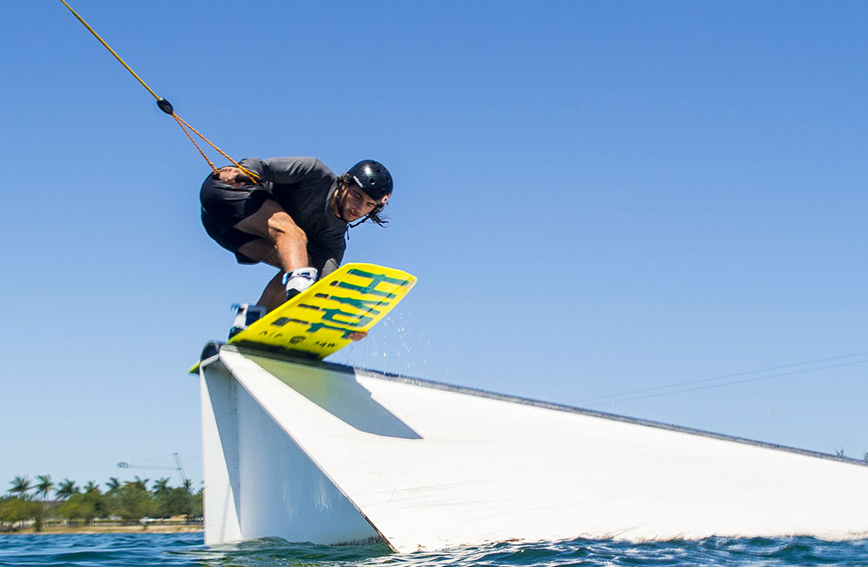
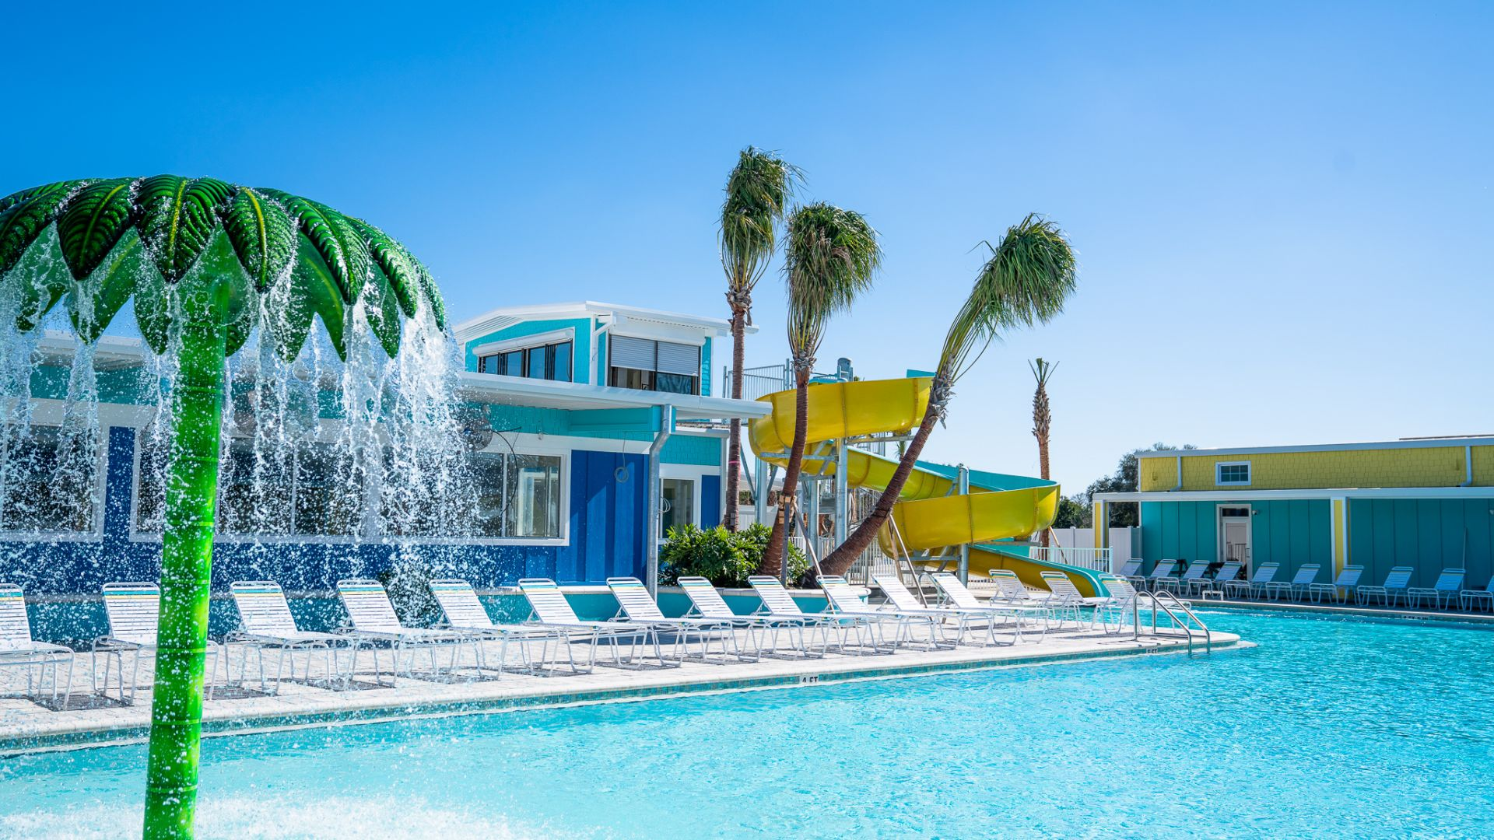
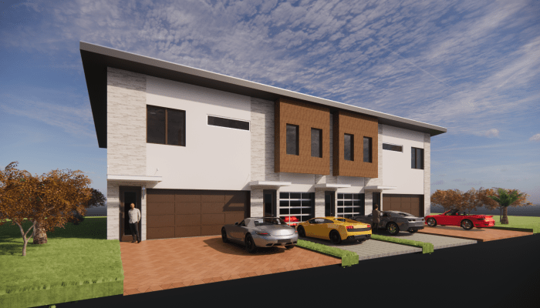
Notes:
11 lighted soccer fields

Slide 4
Projected Growth & Impacts
FY 2021-2022
SINGLE-FAMILY: 579
TOTAL PERMITS: 2,416
NEW BUSINESS TAX RECEIPTS: 529
FY 2022-2023
SINGLE-FAMILY: 712
TOTAL PERMITS: 2,972
NEW BUSINESS TAX RECEIPTS: 493
26% AVERAGE ANNUAL GROWTH RATE

Slide 5
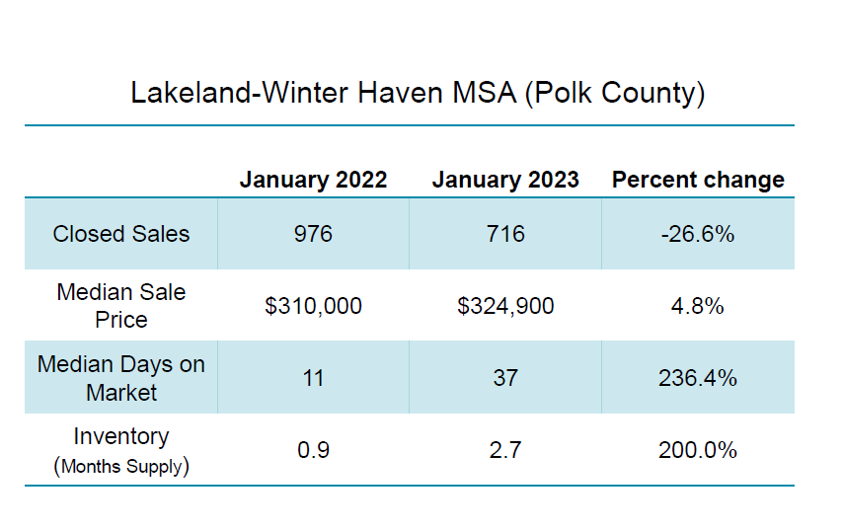
Demographics
Population Estimates: 18,579 (7/1/23)
Population % Increase 2020 to 2023: 19.1%
Persons under 18 years %: 23.1%
Persons 65 years and over %: 16.8%
Female %: 52%
Owner Occupied Housing Rate: 65.7%
Median Household Income: $60,514

Slide 6
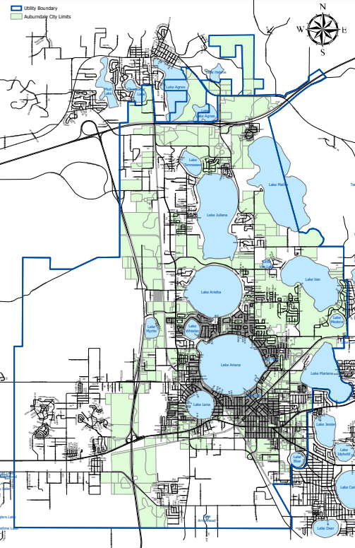

Slide 7
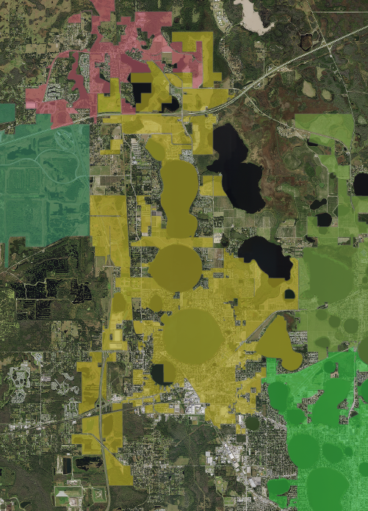
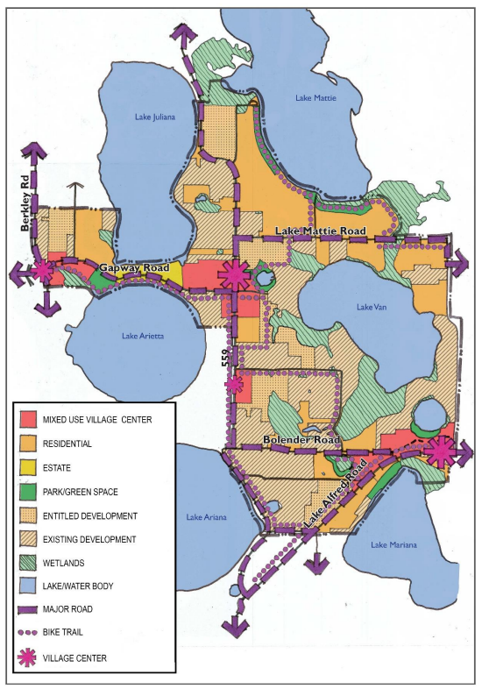
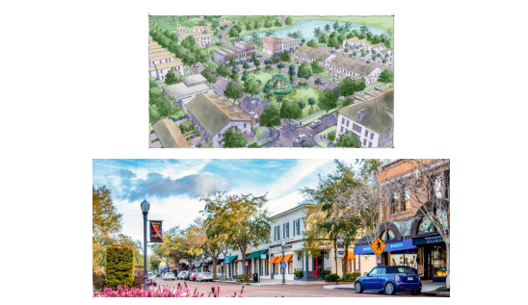
The Lakes District
Master Planned Community
3 Major Property Owners
Community Vision Input
Village Center
Mixed-Use
Max allowed 6 units per acre
Potential for 18,000 units at maximum buildout

Slide 8
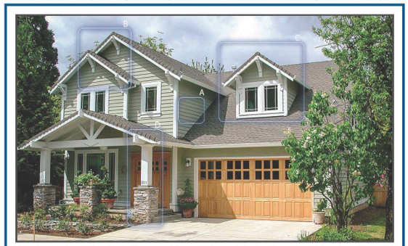
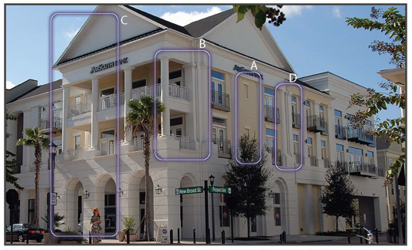
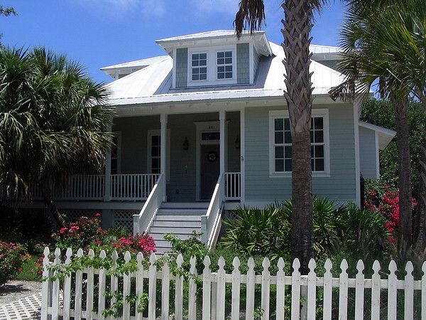
The Lakes District
Connectivity
Architectural Standards
Craftsman
Neoclassical
Old Florida
Modern Farmhouse

Slide 9
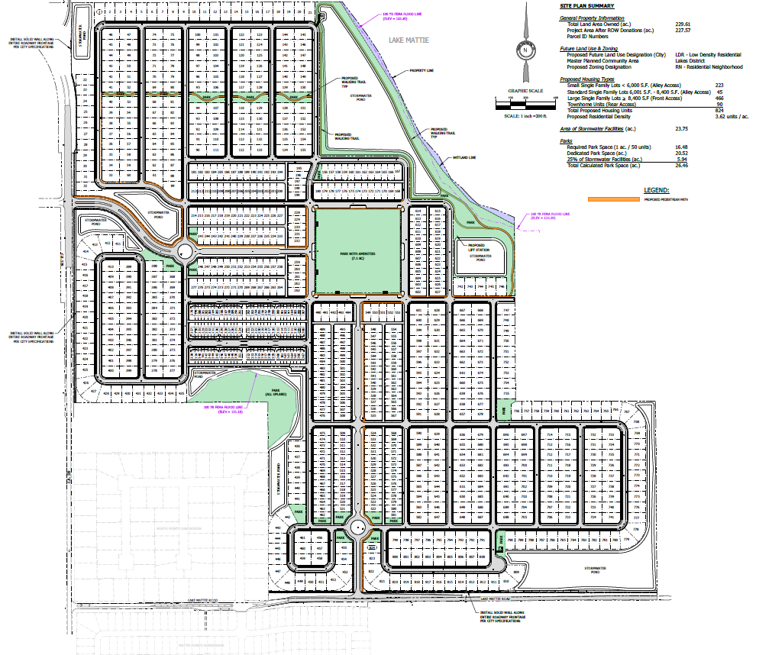
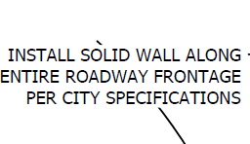
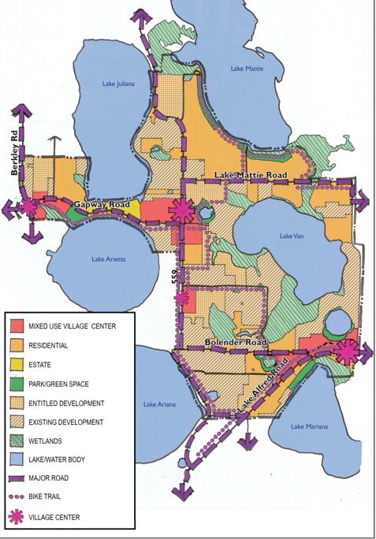
Trail network connections
Ally Access Units

Slide 10
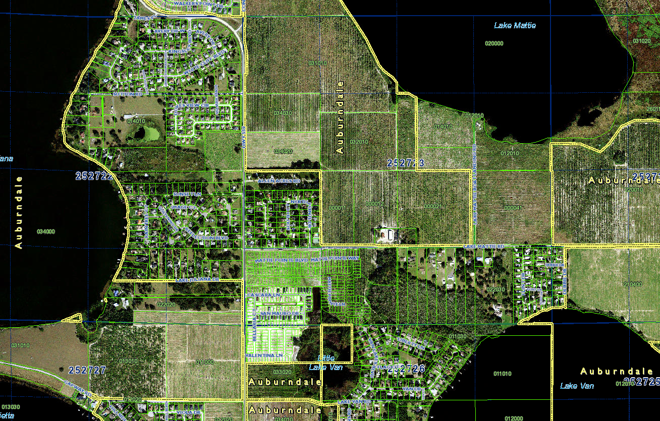
North Auburndale Park

Slide 11
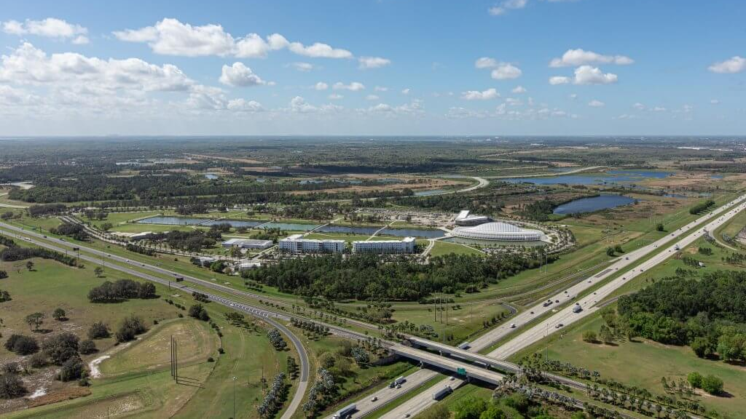
A dense, mixed-use area within cities that connects universities and established institutions with entrepreneurial entities such as startups and business escalators.
The Innovation District

Slide 12
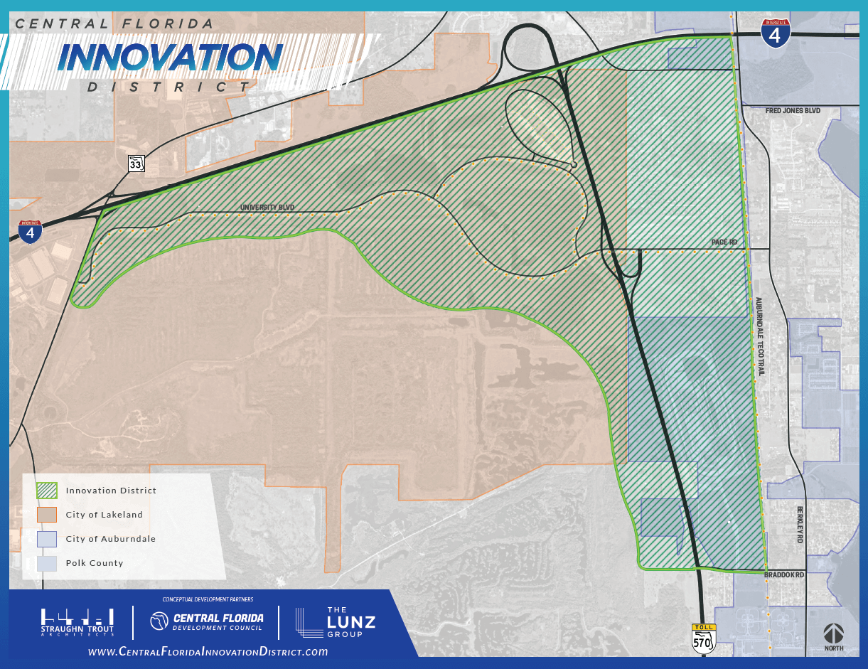
The Innovation District
Not just Lakeland, Auburndale or Polk County…
it’s the Innovation District
$5.2B Total Economic Impact by 2040*
32K Jobs by 2040*
$126M Increase in Tax Revenue by 2040*
Health and Tech
IT, Science, Engineering
Advanced Manufacturing
Mobility and Innovation
SunTrax
Autonomous Vehicles Testing
*CFDC Economic Impact Study 2020

Slide 13
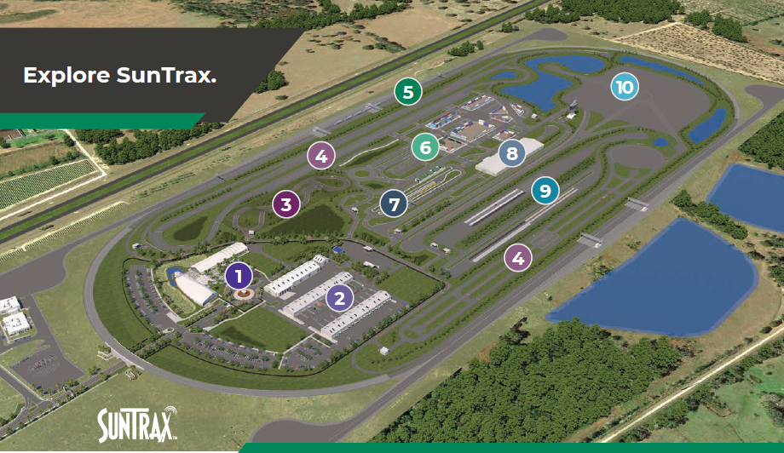
Opened 2022
The site is composed of a 2.25-mile-long test track. The multi-lane track will make it the only high-speed autonomous vehicle (AV) testing facility in the southeastern United States.
The 200-acre infield will focus on
connected and autonomous vehicle (CAV) testing and will feature multiple simulated transportation environments.
A continuously-evolving center for the development of innovative technologies that improve transportation safety, efficiency, and accessibility
Main Entry Campus
• 20,000-sq. ft. Welcome Center
• Offices, classrooms, plus indoor and outdoor event spaces
2
Workshops & Warehouses
• 27,000-sq. ft. warehouse building
• 56,000-sq. ft. air-conditioned workshop buildings with 2,800-sq. ft. bays

Slide 15
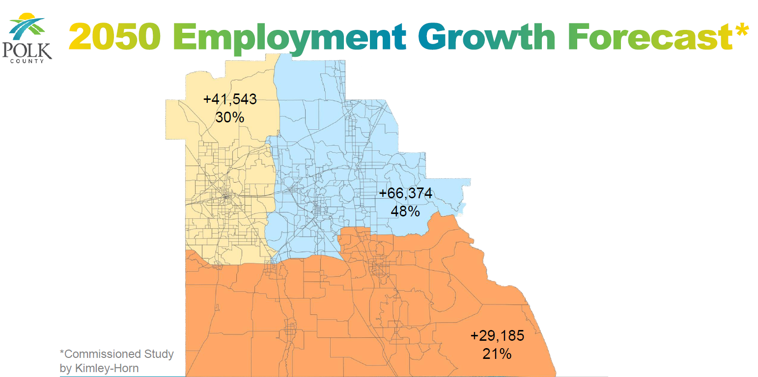

Slide 16
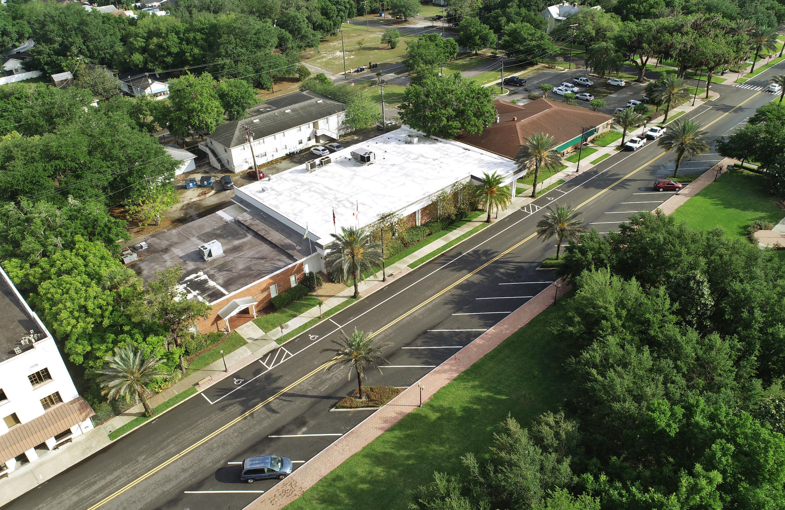
Community Redevelopment Opportunities
Notes:
SunTrust building.
LOI - $1million
Appraisal – $1.75 M
Asking - $1.9 M
Purchase price - $1.8 M

Slide 17
